Slide 1
ECMC Project Machine Learning Initial Models (Small Dataset)
Naif Alshehab
02/14/2024

Slide 2
Introduction

Slide 3
Introduction
Risk (Output) column was assumed
Rest of the flowlines data were selected randomly (343/400,000)
Columns were selected based on relevance (may have not included a representative column)
Risk (Output) could be determined based on technical basis
((Combine Flowline data & age risk factor along with environmental risk data determined by the model shared with us by ECMC))
This makes these models vulnerable to Biases and Errors

Slide 4
Methodology

Slide 5


Dataset
Dataset Components
Spills
123
Instance
323
No Spills
200

Slide 6
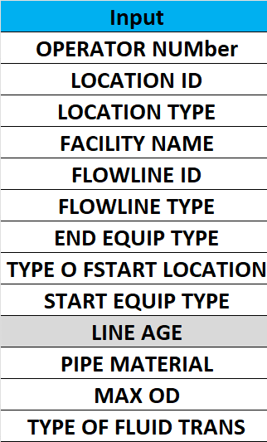

Dataset Features
& Outputs

Slide 7
Data Pre-Processing
1
3
Data Integration
Data Transformation
Transformed categorical columns to (0, 1) multiple columns (dummies)
2
Data Cleaning
Deleted instances with missing data
4
Data Reduction
Applied Principal Component Analysis Method (n=2)

Slide 8
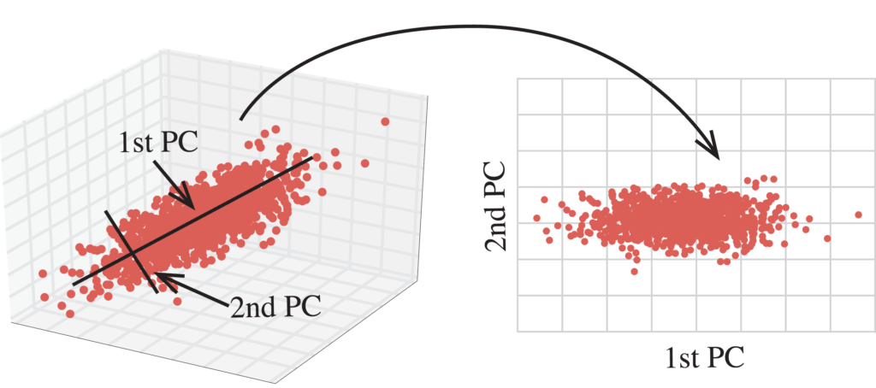
Principal Component Analysis (PCA)
PCA:
Transforms High dimension data to lower dimensions
Maintains most important features (Principal Components)
Captures the maximum variance in a dataset.
Babbar, T. (2023, June 14).

Slide 9
Logistic Regression
Support Vector Machine (SVM)
K Nearest Neighbors (K-NN)
ML Models
Gradient Boosting Decision Trees
AdaBoost
Random Forests
K-Means (Unsupervised)

Slide 10
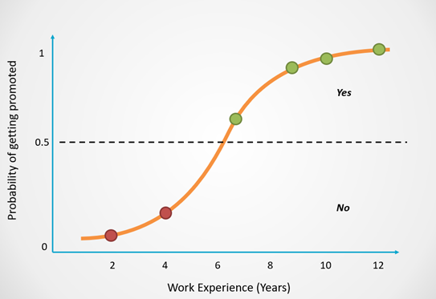
Logistic Regression
LR:
Predicts the probability of the classification of an instant
Works best in binary classifications (Yes/No, High/Low, etc…)
Selvaraj, N. (2022, November 15)

Slide 11
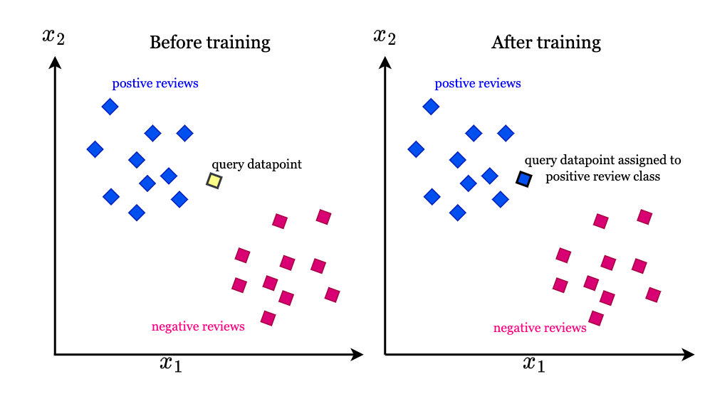
K-Nearest Neighbor
K-NN:
Classifies a point based on how similar it is to neighboring points
Calculates the distance between a point and k number of closest points
S H, Roshna. K-Nearest Neighbors Algorithm

Slide 12

Support Vector Machine
SVM:
Finds the best hyperplane to separate datasets into classes (Statistical)
Best hyperplane is one that achieve max distance from classes
Works best in with small & complex datasets
Selvaraj, N. (2022, November 15)

Slide 13
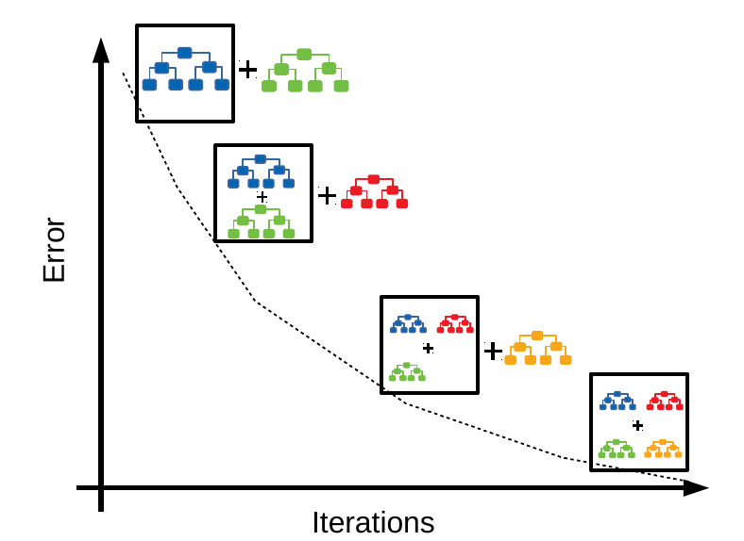
Gradient Boosting Decision Trees
GBDT:
Combines many weak predicting decision trees to form a strong predictor ensemble model
Usually yields a powerful predictive model
Pal, A. (2020, October 1)

Slide 14
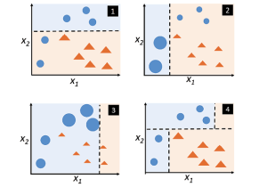
Adaptive Boosting
AdaBoost:
Creates an initial weak classifier with equal weights
Modifies the weights until a strong classifier is reached
Kumar, A. (2020, September 9)

Slide 15
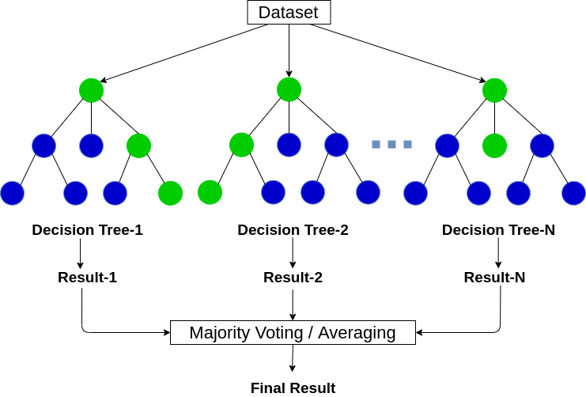
Random Forests
RF:
An ensemble of multiple decision trees.
Each tree is created using a random subset.
Predicts based on the majority average of all the trees
Curry, R. (2021, December 21)

Slide 16
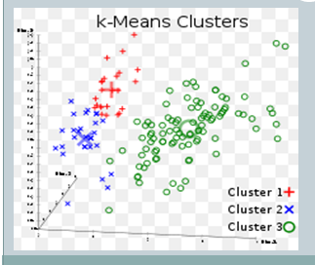
K-Means Clustering (Unsupervised)
K-Means:
Splits the data into K number of clusters
Reduces the distance of each point by matching it with nearest cluster
Great for classifying a dataset based on similar features
Yusuf, F. (2023, June 1)

Slide 17
Cross Validation
Divided the data set into:
5 train/test splits
Calculated Mean F1 Score

Slide 18
Results

Slide 19
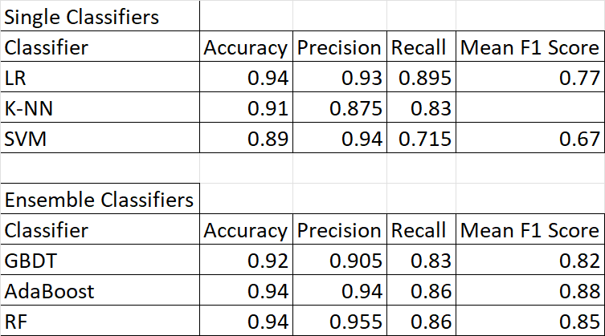
Results – Full Dataset

Slide 20
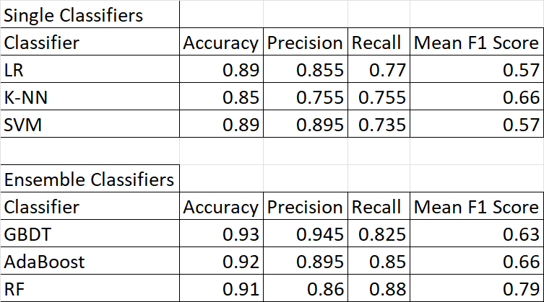
Results - PCA

Slide 21
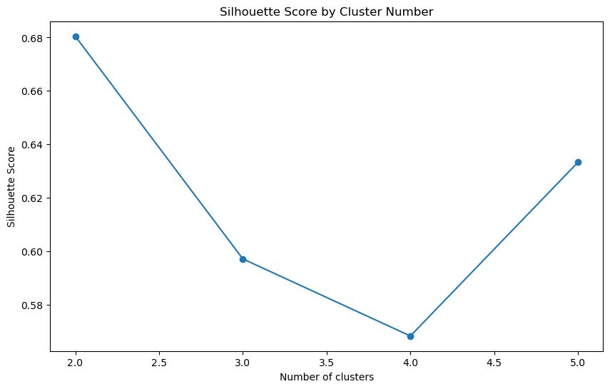
Unsupervised ML Results

Slide 22
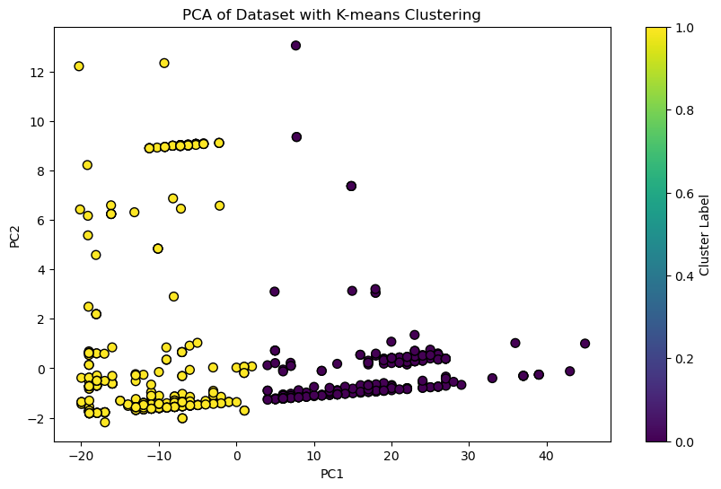
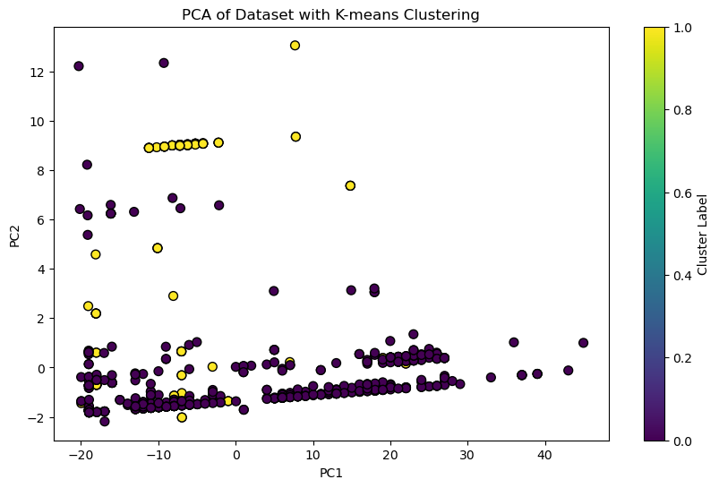
Unsupervised ML Results
Model
2 Clusters
Actual Classifications

Slide 23
Thank You!

Slide 24
Reference
Andika Rachman, R.M. Chandima Ratnayake, Machine learning approach for risk-based inspection screening assessment, Reliability Engineering & System Safety, Volume 185, 2019, Pages 518-532, ISSN 0951-8320, https://doi.org/10.1016/j.ress.2019.02.008.

